Slide 1

Principal Supervisor Accreditation Program
School of Science, Center for Securing Digital Futures
AI in Academic Research
Dr. Ahmad Mohsin

Slide 2
Gen AI in Academic Research
School of Science
A perspective for Supervisors and HDR Students

Slide 3

What is Gen AI: A Researcher Perspective?
“Generative AI in Research utilises advanced models such as LLMs to generate content, significantly accelerating scientific discovery, enhancing creativity, and optimizing research workflows. It supports a wide range of applications, such as data generation, hypothesis development, literature review, and the production of novel research materials, streamlining complex processes across diverse academic disciplines”.
Human- AI Collaboration
Adopted from various articles and online sources during the development of this presentation
Notes:
AI and its implications for research in higher education: a critical dialogue
https://www.tandfonline.com/doi/epdf/10.1080/07294360.2023.2280200?needAccess=true

Slide 4
Use of Gen AI in Australian universities
A recent survey in September 2024 reveals that almost 71% of Australian university staff including Academics are using Generative AI Tools.
On Average 60% are using it for Literature search analysis Text Summary Analysis and day-to-day tasks.
10% use AI for Data Analysis, Visualisations and task Automation
Notes:
A survey:
https://eprints.qut.edu.au/252079/1/Engagement_with_Generative_AI_by_Australian_University_Staff_Final_Report.pdf
Conversation Article
https://theconversation.com/71-of-australian-uni-staff-are-using-ai-what-are-they-using-it-for-what-about-those-who-arent-240337

Slide 5
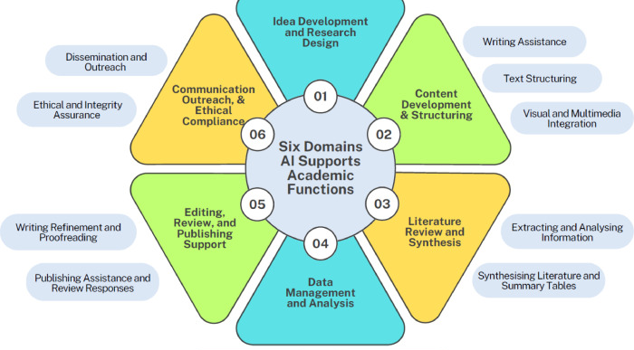
How are Researchers using AI?
Notes:
Using artificial intelligence in academic writing and research: An essential productivity tool
https://www.sciencedirect.com/science/article/pii/S2666990024000120

Slide 6
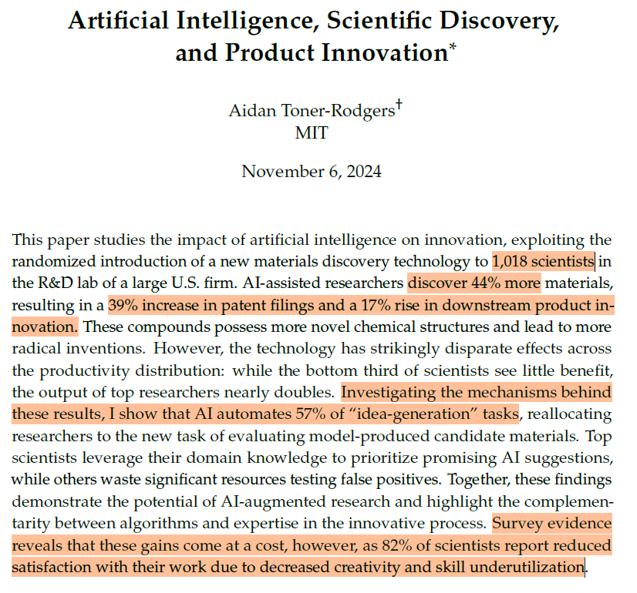
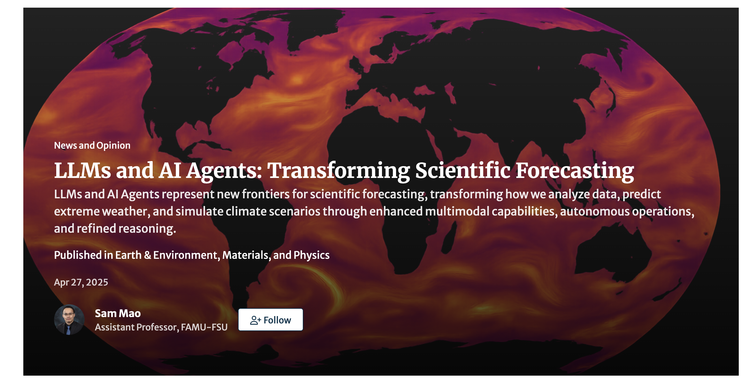
AI: Innovation and Discovery in Research
https://communities.springernature.com/posts/llms-and-ai-agents-transforming-scientific-forecasting
Notes:
https://aidantr.github.io/files/AI_innovation.pdf

Slide 7

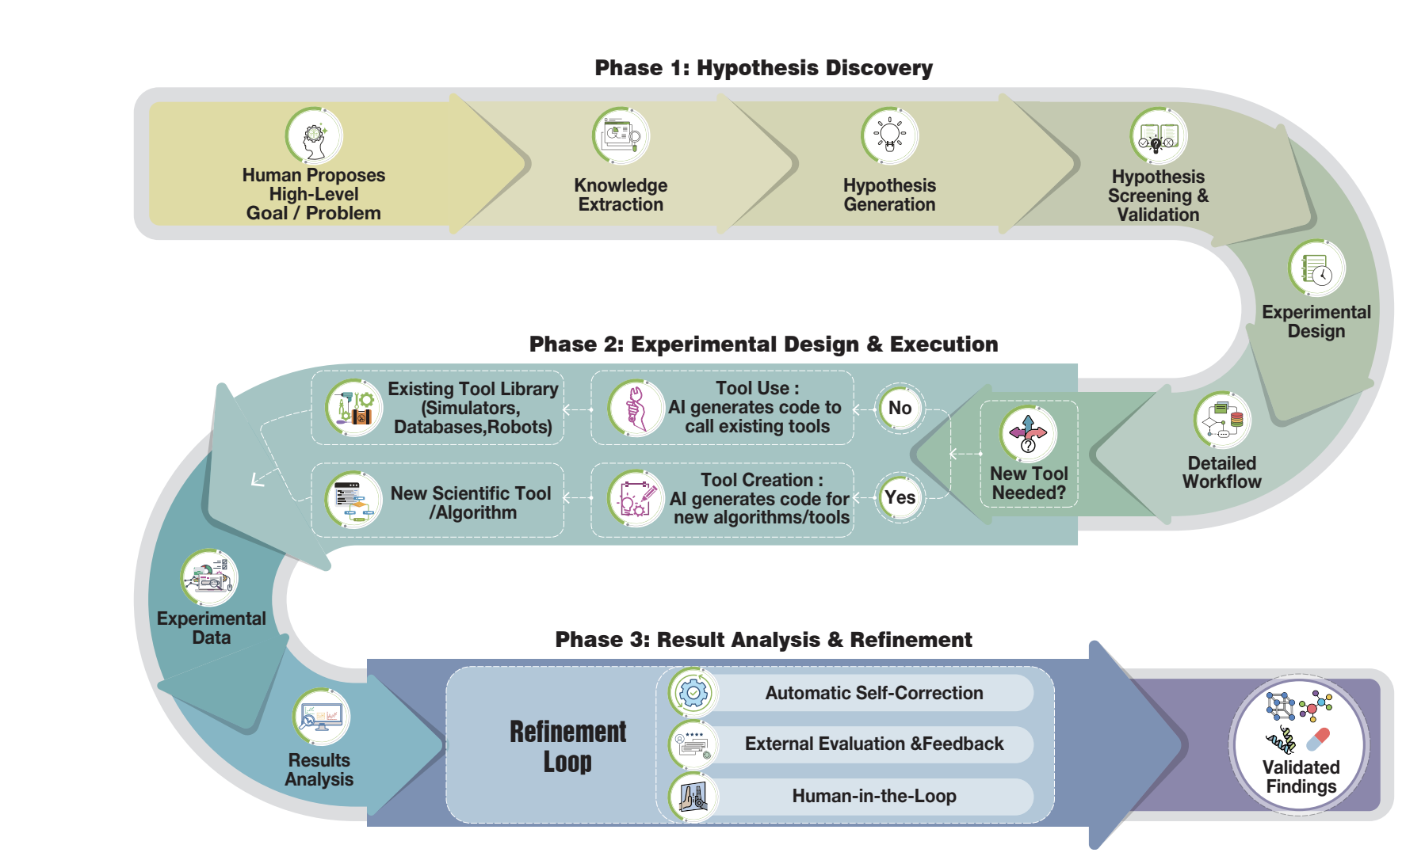
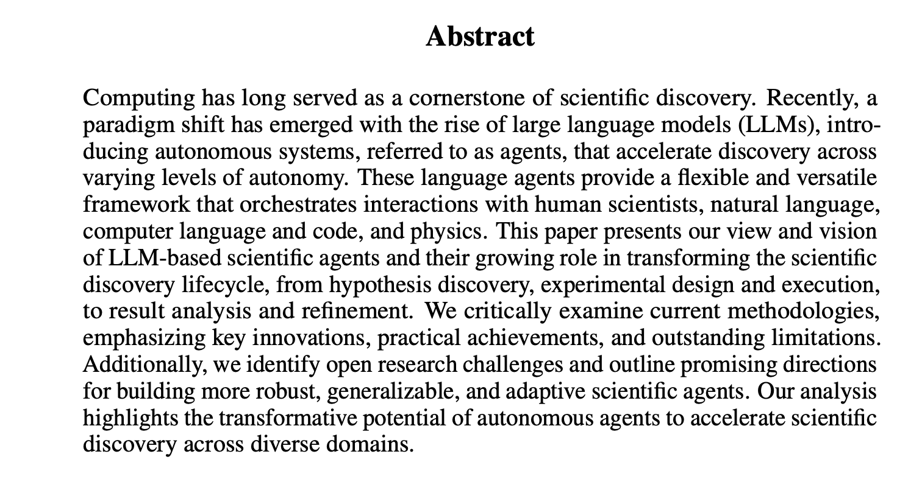
https://arxiv.org/pdf/2510.09901v2

Slide 8
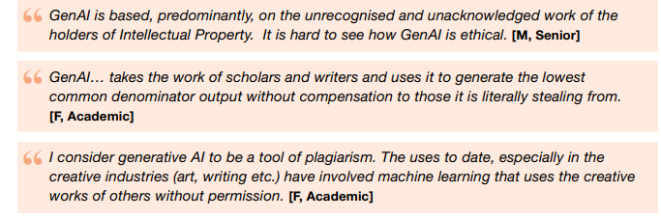
Researchers Concerns

Slide 9
Human Intelligence and AI in Research
 | Human Intelligence | AI Intelligence | HI+AI in Research
Creativity, Innovation | Human Intelligence is at top, where research needs innovation. | AI is an aiding tool for brainstorming of ideas around innovation but not actual innovation | Driven Through HI where philosophy is lead by Humans. AI can team up Humans to speed up innovation and creativity process.
Adaptability | HI can evolve according to complex situations and environments, can comprehend Philosophical thoughts | Good in known specific tasks for research, not able to adapt to new situations i.e. if a research hypothesis is failed? | HI, and human intellectual research though process to improve automation and aiding solving complex problems
Cognitive Processing | HI can process complex cognitive tasks required in a research | AI can do certain cogitative tasks at high speed i.e. Data Analysis, mathematical tasks in certain research stages | HI and AI can collaborate effectively for certain Research tasks.

Slide 10
AI and Research Journey stages
Early Candidature: Research Students
Mid Candidature Stages
Develop Essential Research methodologies, critical thinking, formulating research ideas, research planning data collection, and Analysis.
  Brainstorming (Human collaborators Vs AI)
  Learn to Develop Scientific AI Queries and prompt Engineering
  AI-Driven Survey Existing methods
Any Stage
  Editorial Assistance (Grammarly)
  Proof Reading
  Language Improvement
HDRS Maturity Stages
Towards Thesis Submission
  Scientific Research Methods, Domain Knowledge and Problem Rigor
  AI- Coding
  Data cleansing, Analysis,
  Visualizations
  Understand
  AI policies prior to publication in Journals and Conferences
  Avoid
  Substantive use of AI (Thesis, journal articles)
Notes:
My notes:
Effective and Responsible Use of AI in Research: Guidance for Performing Graduate Research and in Writing Dissertations, Theses, and Manuscripts for Publications
https://grad.gatech.edu/sites/default/files/documents/Guidance%20for%20Effective%20and%20Responsible%20Use%20of%20AI%20in%20Research.pdf

Slide 11
Getting Ready for AI-Driven Research
Fundamental Literacy for AI models and Tooling in Higer Education
Universities must be at pace to respond how Students, Academics and Industry Partners are using AI in Research.
Move from doom or hype to reality and should clearly know benefits and risks of AI driven Research.
Open Source and Commercial AI Tools for Academic Research
Leverage AI to push the frontier of scientific knowledge.
industry standards for the responsible use of AI in scientific discovery

Slide 12
Supervisors Role
Supervisors must be equipped with necessary AI tooling and literacy
Start open discussions among students concerning the use of AI.
Encourage Research students to gain fundamental knowledge of AI tooling.
Explore downstream AI models for Research purposes
Provide explicit guidelines on using AI at different stages of a research journey.

Slide 13
Ethical Use of AI in Research (Students, Supervisors, and Org. Roles)
Research Supervisors and Students
Responsible for Scientific Output regardless of AI usage
Language support is not a replacement for HI critical thinking and contextual knowledge.
Researchers should rely on critical thinking to supplement AI’s output.
Transparency and Integrity
Data Privacy and Confidentiality
v
Student proposal Development
(Not Desired)
Interpretation and Conclusions
(Don’t)
AI-Peer Reviews and Assessments (Don’t)
Competitive Research Grants (Subjective)
Frameworks, Guidelines Evolution
Domain-Specific use of AI in Research
AI Governance, Monitoring and Auditing
Leverage AI to push the frontier of scientific knowledge
Notes:
My notes:
Living guidelines on the RESPONSIBLE USE OF GENERATIVE AI IN RESEARCH
https://research-and-innovation.ec.europa.eu/document/download/2b6cf7e5-36ac-41cb-aab5-0d32050143dc_en?filename=ec_rtd_ai-guidelines.pdf
Responsible artificial intelligence research
A UNIVERSITY FRAMEWORK FOR THE RESPONSIBLE USE OF GENERATIVE AI IN RESEARCH
https://arxiv.org/pdf/2404.19244

Slide 14
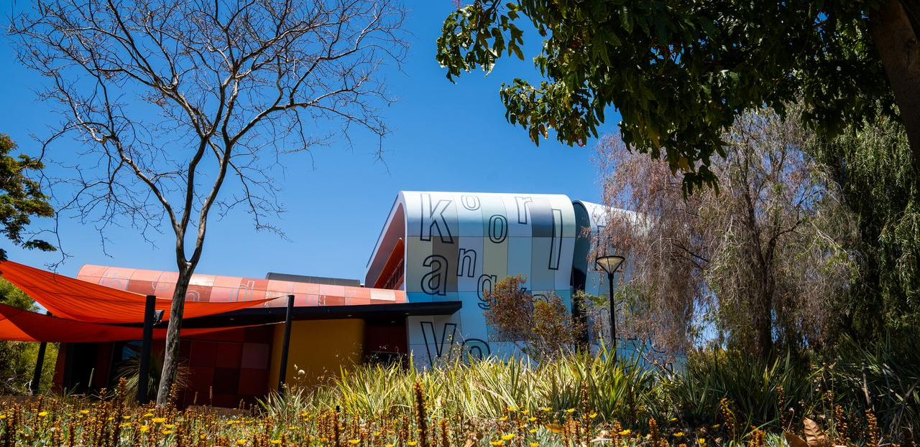
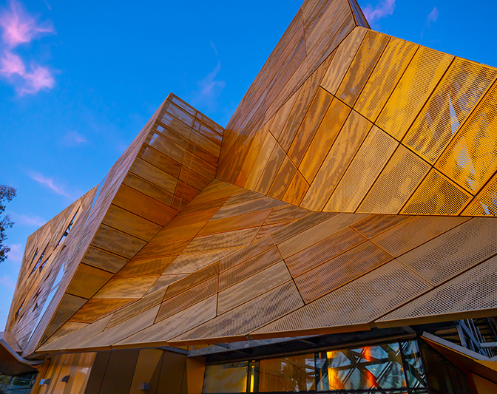
Thank you.
Dr. Ahmad Mohsin
a.mohsin@ecu.eud.au

